Slide 1
Conscious Living

Slide 2

Agenda
Introduction to Conscious Living
Key principles
Emotional Awareness
Benefits
Challenges and Solutions
Conclusion
Conscious living & Physical environment

Slide 3

Introduction To Conscious Living
Living with awareness and intention
Being mindful of thoughts, actions, and choices
Aligning life with values and purpose
Not reacting, but responding consciously
“

Slide 4

Importance of Conscious Living
Reduces stress and anxiety
Improves mental clarity
Enhances emotional stability
Leads to a more fulfilling life

Slide 5

Key Principles
Mindfulness: Being fully present and aware in the current moment without distraction.
Self-awareness: Understanding your own thoughts, emotions, and behavior.
Intentional actions: Making conscious choices that align with your values and goals.
Gratitude: Appreciating and being thankful for what you have in life.

Slide 6

Emotional Awareness
Understanding emotions
Responding instead of reacting
Managing stress effectively
Developing emotional intelligence

Slide 7

Benefits of Conscious Living
Inner peace
Better decision-making
Stronger relationships
Personal growth

Slide 8
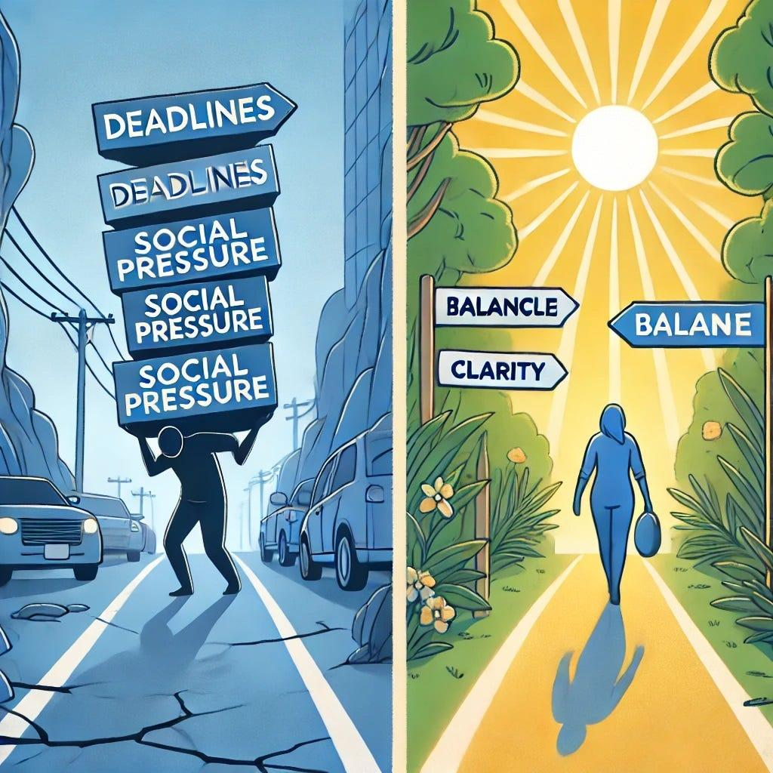
Challenges & Solutions
Challenges:
Distractions
Stressful lifestyle
Overthinking
Solutions:
Practice mindfulness
Set clear intentions
Limit distractions

Slide 9

🌍 Conscious Living & Physical Environment
🌱 Awareness: Understanding how daily actions impact
nature
♻️ Responsible Choices: Reduce, reuse, recycle
🌿 Sustainable Living: Eco-friendly habits and minimalism
🌍 Environmental Impact: Protecting resources for
future generations

Slide 10

Conclusion
Conscious living is a lifelong journey
Small changes create big impact
Awareness leads to transformation
Start today, live intentionally

Slide 11

Thank You

